Slide 1
HW2: The World is Round

Slide 2
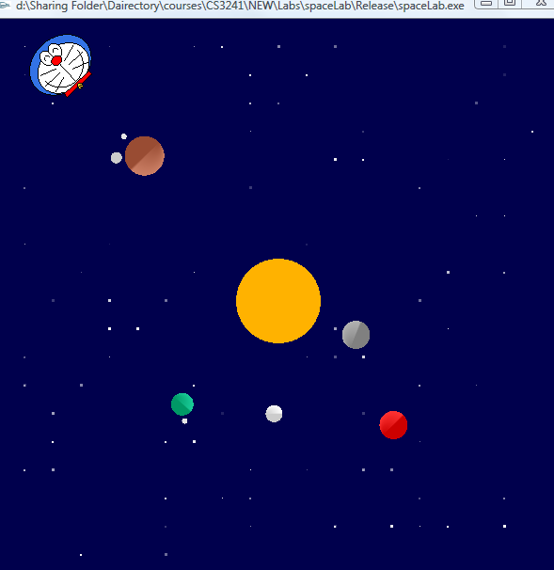
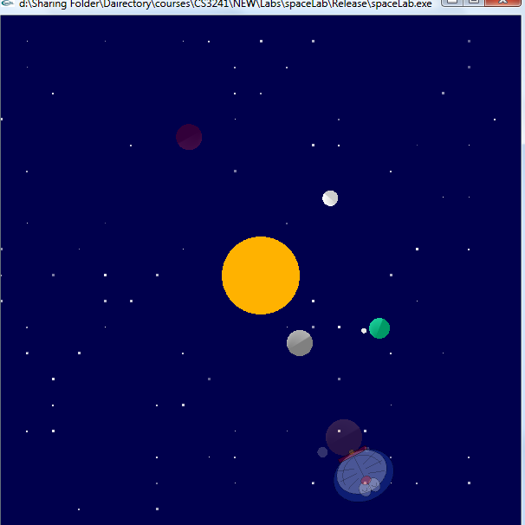
Lab 2: The World is Round
Solar System Mode
Clock Mode
(5:07:20)
7 min.
20 sec.
Toggle by the key “T”
5 o’clock

Slide 3
Solar Mode
Jumping/spinning around a locate planet
Requirement: some motion with respect to local frames
E.g. a moon spinning around a planet and Doraemon jumping on a planet
You are allowed to reuse your code in Lab 1
Even non-circular orbits are allowed (bonus feature!)
Elliptic, hyperbolic, etc…
But not linear
Rotating around the sun

Slide 4
Solar Mode: Aim
Understanding the usage of local reference frames
You may even try more than one layer of reference frame

Slide 5
Clock Mode
Requirement
Moving “clock arms” according to the time
Showing hours, minutes and seconds
You can dim/add/subtract objects to/from the solar mode
5:07:20
7 min.
20 sec.
5 o’clock

Slide 6

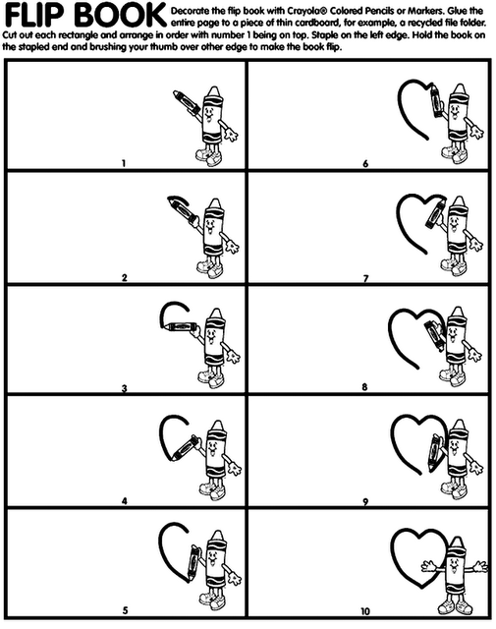
Animation
Displaying different frames according to time
However, GLUT main loop sleeps if there is no event
Thus, the display function will not redraw a new picture/frame
Need to register a function to wake the program when idling

Slide 7
glutIdleFunc
Use glutIdleFunc(myIdle) to register a function myIdle()
So that myIdle()will be called whenever the program is idle
A very simple idle function :
void myIdle(void)
{
glutPostRedisplay();
}
This function posts a “redisplay” event (thus, call your display function) whenever the program is free

Slide 8
glutPostRedisplay()
A common misconception: glutPostRedisplay() tells OpenGL to refresh the screen when next convenient
ie. glutPostRedisplay() ≠ Redraw screen now
Purpose of this function: Mark as dirty
Indicate that something has changed
You should not be calling glutPostRedisplay() multiple times in quick succession

Slide 9
Try This
void myIdle(void)
{
glutPostRedisplay();
}
void myDisplay()
{
glPushMatrix();
time_t current_time = time (NULL);
struct tm * timeinfo = localtime(&current_time);
double angle = 360-(float)timeinfo->tm_sec/60*360;
glRotatef(angle,0,0,1);
drawSomething();
glPopMatrix();
}

Slide 10
Clock Mode
Get number of seconds from 00:00:00 1 Jan 1970
time_t time(NULL);
Then use the function localtime to convert to local time, e.g. Calculating the angle for the second needle
time_t current_time = time (NULL);
struct tm * timeinfo = localtime(&current_time);
double angle = 360-(float)timeinfo->tm_sec/60*360;
But if you want something up to millisecond, you need some other timing function of C++

Slide 11
Using time_t and tm
time_t current_time = TIME( NULL );
Create a time_t object from the current time
struct tm *timeinfo = localtime( &current_time );
Represent the current time as a struct of type tm
Store it in a pointer called timeinfo

Slide 12
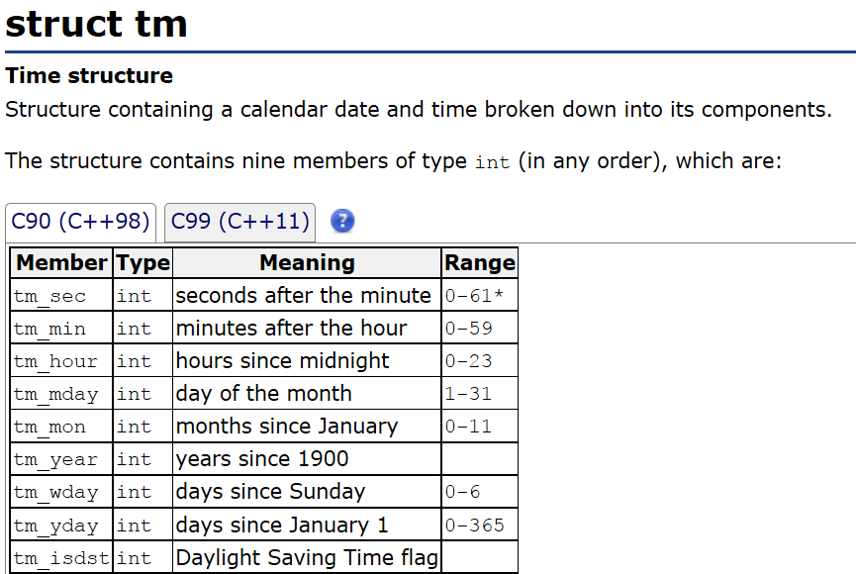
Source
http://www.cplusplus.com/ reference/ctime/tm/

Slide 13
Transparency

Slide 14
Transparency
Use of alpha channel
32-bit graphics systems contain four channels:
three 8-bit channels for red, green, and blue (RGB) and one 8-bit alpha channel
Rendering overlapping objects that include an alpha value is called alpha blending

Slide 15

Transparency
Use of alpha channel

Slide 16
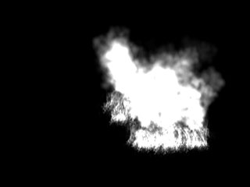
Transparency
Use of alpha channel

Slide 17

Transparency
Use of alpha channel

Slide 18
Transparency
Use of alpha channel
Color transparency
glBlendFunc(GL_SRC_ALPHA, GL_ONE_MINUS_SRC_ALPHA)
glEnable(GL_BLEND)
glColor4f(GLfloat red, GLfloat green, GLfloat blue, GLfloat alpha)
(Alpha values: 0.0=Fully Transparent; 1.0=Fully Opaque)
What’s more?
Google for OpenGL texture transparency, if you are interested

Slide 19
Transparency
Try out
glBlendFunc(GL_SRC_ALPHA, GL_ONE_MINUS_SRC_ALPHA);
glEnable(GL_BLEND);
glColor4f(0,0,1,0.5);
glBegin(GL_POLYGON);
glVertex3f(-2,-1,0);
glVertex3f(2,-1,0);
glVertex3f(2,1,0);
glVertex3f(-2,1,0);
glEnd();
glColor4f(0,1,1,0.4);
glBegin(GL_POLYGON);
glVertex3f(-1,-2,0);
glVertex3f(1,-2,0);
glVertex3f(1,2,0);
glVertex3f(-1,2,0);
glEnd();

